Slide 1

From Penguins to Pyro: A Data Adventure
Abbey Allen, Ben Shaw

Slide 2
The Palmer Penguin Dataset
Number of species: 3. Names: Adelie (146), Gentoo (119), Chinstrap (68).
Number of attributes of a given penguin: 8, including species.
Names of attributes: species, native island (near antarctica), bill length, bill depth, flipper length, body mass, sex, and year (the year the measurement was taken).
345 rows.
Data were collected and made available by Dr. Kristen Gorman and the Palmer Station Long Term Ecological Research (LTER) Program.

Slide 3
Data Preparation
Goal: Predict the Species of penguin given only the bill length and bill depth.
Convert species to integer values 0, 1, 2.
2 rows with missing values: dropped from consideration.
The data was standardized, since the bill length attribute has larger values.
80% of the data was used for training, 20% for validation.

Slide 4
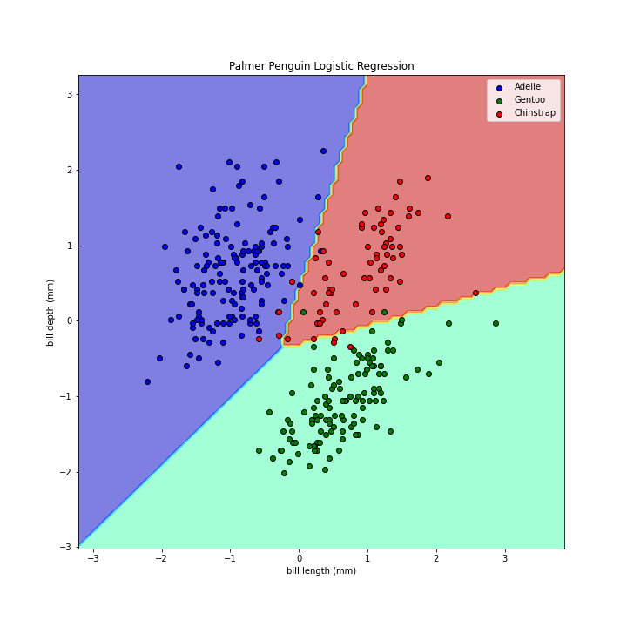
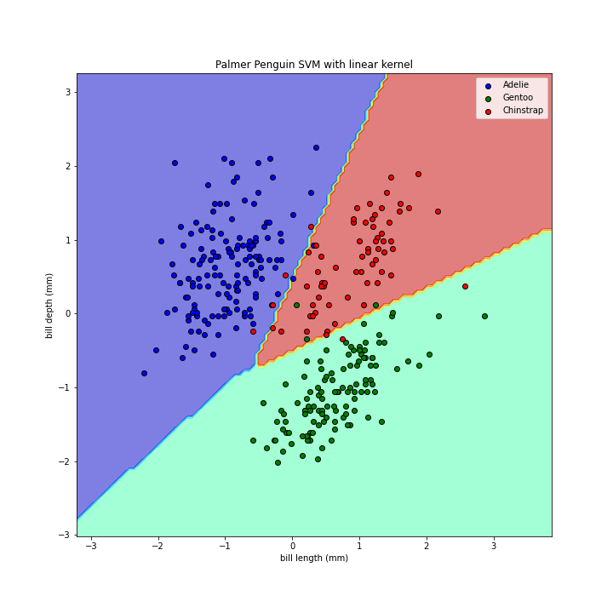
Classification results
Validation Accuracy: 0.925
Validation Accuracy: 0.94

Slide 5
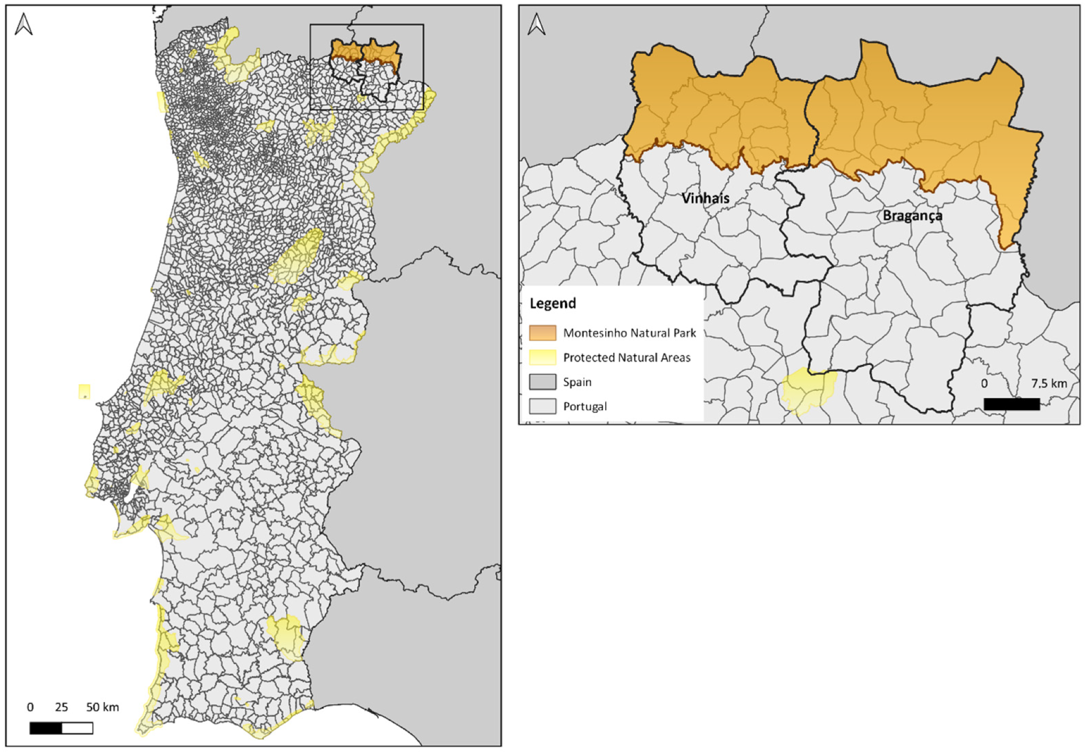
Forest Fires
Information from Montesinho natural park in Portugal from Jan 2000 to Dec 2003
Contains 517 forest fire instances
13 attributes:
X & Y
Month
Day
Fine Fuel Moisture Code (FFMC)
Duff Moisture Code (DMC)
Drought Code (DC)
Initial Spread Index (ISI)
Temperature
Relative Humidity
Wind
Rain
Area Burned
Image Credit: https://www.mdpi.com/2071-1050/14/7/4373
Dataset: http://www.dsi.uminho.pt/˜pcortez

Slide 6
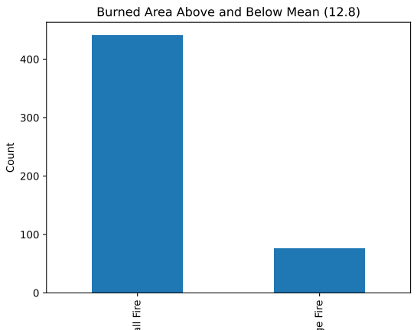
Data Preparation
Month and Day
Assigned numerical values using a dictionary for visualizations
One-hot-encoding for LG and SVM
Standardized Features
Wind
Temp
Target Variable to Binary Variable
Determine if a fire is small or big based on different attributes
Threshold as 2 values
Mean: 12.8
Mode: 0.52
Relative Humidity
Rain
Burned area varied significantly by month and week, with higher areas observed on weekends and in fall months.

Slide 7
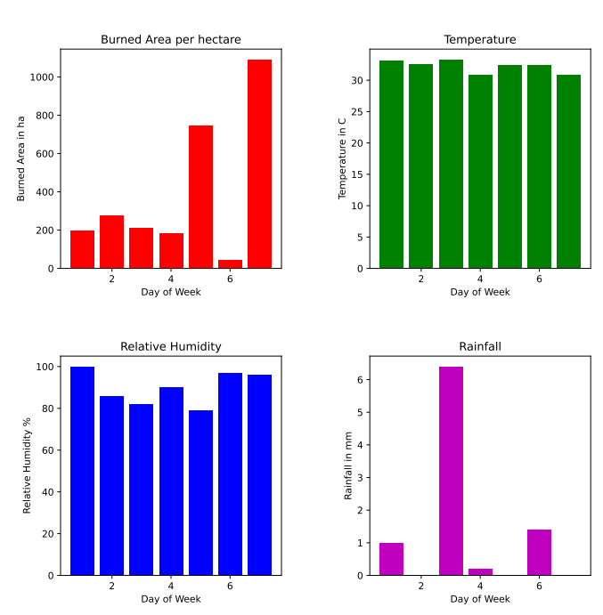
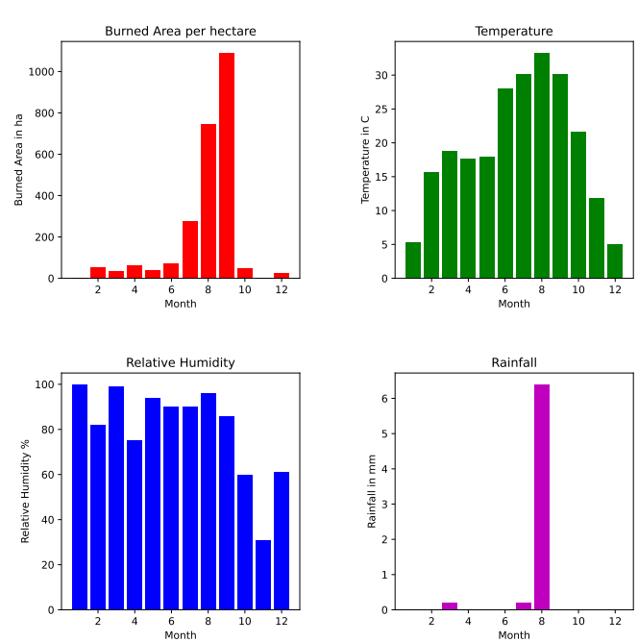
Fire Attributes over Time

Slide 8
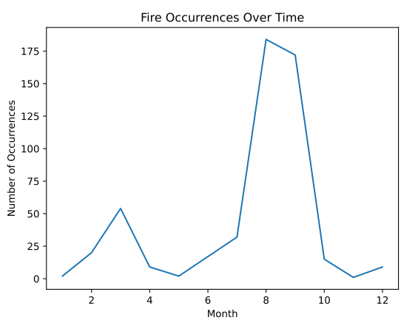
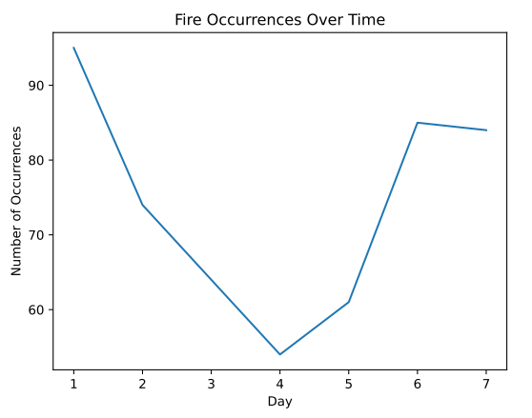
Fire Instances over Time

Slide 9
Results
Mean achieved 85.7% accuracy
Median achieved 51.9% accuracy.
This approach can assist the forest service in preventing fires or detecting them when they are still small.
Results were consistent when applying SVM using the same attributes and target value.

